Slide 1
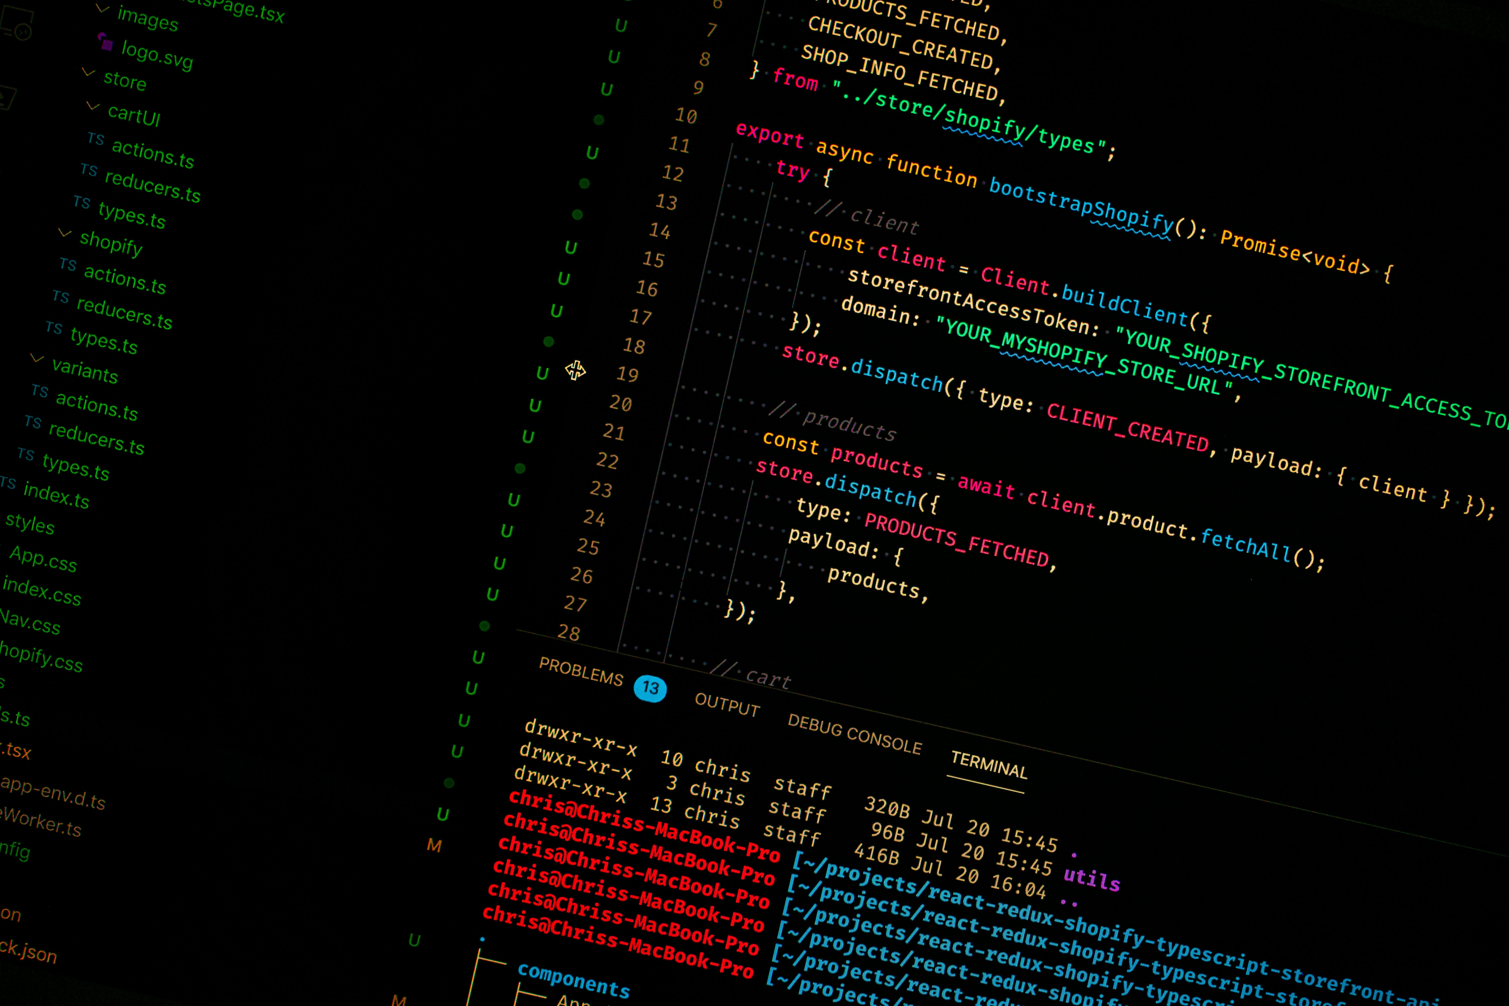
Programming
Programming

Slide 2
Programming

